Slide 1
COMP5423 Natural Language Processing

Slide 2
Course Introduction

Slide 3



Course Introduction
Lecturer (Responsible for Lecture Classes)
Maggie, Wenjie Li
cswjli@comp.polyu.edu.hk
PQ707
Tutors (Responsible for Labs and Project)
Dongding Lin, 22037064r@connect.polyu.hk, PQ719
Heming Xia, 23123186r@connect.polyu.hk, QT415

Slide 4
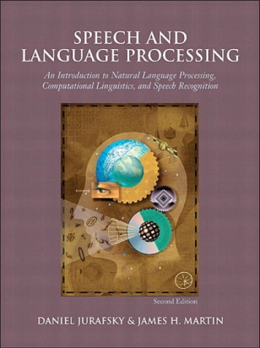



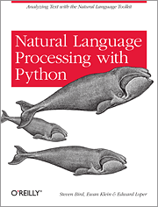
Course Introduction
Reference Books
Speech and Language Processing: An Introduction to Natural Language Processing, Computational Linguistics and Speech Recognition (P98.J87)
Foundations of Statistical Natural Language Processing (P98.5.S83 M36)
Natural Language Processing with Python: Analyzing Text with the Natural Language Toolkit (QA76.73.P98 B57)
Notes:
Speech and Language Processing, Dan Jurafsky from Stanford University
Foundations of Statistical Natural Language Processing, Christopher Manning from Stanford University
Natural Language Processing with Python – Analyzing Text with the Natural Language Toolkit (NLTK)

Slide 5

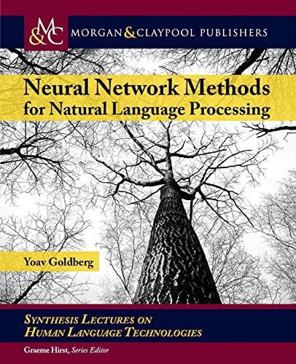
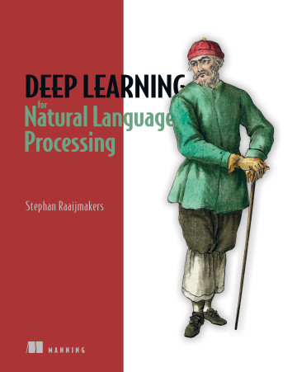




Course Introduction
Reference Books
Introduction to Information Retrieval (QA76.9.T48)
Neural Network Methods in Natural Language Processing (PolyU Library Online Access)
Deep Learning for Natural Language Processing (PolyU Library Online Access)
Notes:
自然语言处理：基于预训练模型的方法 (HIT)
自然语言理解 (Shanghai Jiao Tong University)

Slide 6

Course Introduction
Teaching Materials
Lecture notes, lab materials, lecture homework, lab assignment, project description, and supplementary reading materials, etc. are downloadable from Blackboard.
Lecture notes and lab materials are normally available one day before class.
Submit your homework, assignment, project code and report to the Blackboard by due time. The penalty for late submission (no later than one week) is a reduction by up to 10% of the total mark.

Slide 7
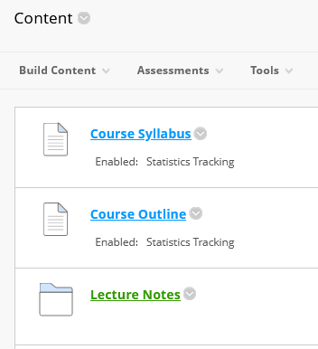
Course Introduction
Tentative Teaching Arrangement and Schedule
Lecture Sessions (FJ304)
Weeks: 1, 2, 3, 5, 6, 9, 11, 12 and 13
Lab Sessions (PQ604A/B/C)
Weeks: 4, 7 and 10
Mid-Term Quiz
Week: 8
See “Course Outline” in Blackboard for reference.

Slide 8
Course Introduction
Method of Assessment
Course Work 55%
Homework 5%
Lab Assignment 5%
Mid-Term Quiz 25%
Group Project 20%
Final Examination 45%

Slide 9
Course Introduction
Tentative Teaching Content
Information Retrieval, Sentiment Classification, Dialogue Systems, and etc.
Morphological Analysis:
Tokenization, Lemmatization,
Stemming,
Word Segmentation
Semantic Analysis:
Sense Disambiguation,
Word Embedding,
Semantic Labeling
Language Models:
N-Gram Language Model
Neural Language Model
Large Language Model
Syntactic Analysis:
Part-of-Speech Tagging,
Syntactic Parsing
Discourse Analysis
Natural Language Understanding
Natural Language Generation
Text Classification, Ranking, Generation, and Sequence Labeling
Notes:
Overall Picture of NLP

Slide 10
Course Introduction
Tentative Teaching Content
Lecture Sessions: NLP Concepts, Models, Approaches and Applications
Natural Language Understanding (NLU)
Morphological/Lexical Analysis: Tokenization, Stemming/Lemmatization, Chinese Word Segmentation
Syntactic Analysis: Part-of-Speech (POS) Tagging, Syntactic Parsing (Constituency Parsing, Dependency Parsing), Chunking, Context-Free Grammar (aka. Phrase-Structure Grammar)

Slide 11
Course Introduction
Tentative Teaching Content
Natural Language Understanding (NLU)
Semantic Analysis: Word Sense Disambiguation, Word Embedding, Semantic Role Labeling
Discourse Analysis: Co-Reference Resolution, Coherence Modeling
Natural Language Generation (NLG)
N-Gram Language Models, Neural Language Models, Word-by-Word Generation, Rule-based Generation, Template-based Generation
Notes:
意义meaning
意义；含义；理解…的方式；看待…的角度the meaning that a word or phrase has; a way of understanding sth.

Slide 12
Course Introduction
Tentative Teaching Content
NLP Applications
Information Retrieval (Ranking)
Sentiment/Emotion Analysis (Classification)
Information Extraction and Knowledge Discovery (Sequence Labeling)
Question Answering (Classification, Information Retrieval and Information Extraction)
Machine Translation (NLU and NLG)
Text Summarization (Ranking, NLU and NLG)
Dialogue Systems (NLU, NLG, QA, IR, Recommendation)

Slide 13







Course Introduction
Tentative Teaching Content
Lab Sessions: NLP Toolkits like NLTK and Stanford CoreNLP, Neural Language Models like BERT, GPTs and ChatGPT, Large Language Models like LLAMA, MISTRAL and etc.
Group Project: TBC

Slide 14
Course Introduction
Pre-Requisites
No Pre-Requisites? Definitely NOT!
Machine Learning Knowledge: Classification (e.g., SVM, NB, Random Forest), Sequence Modeling (e.g., Hidden Markov Models), Neural Network Models (e.g., Feedforward Neural Networks)
Programming Skill: Python
Please find the “Supplementary Reading Materials” in Blackboard for your reference.

Slide 15
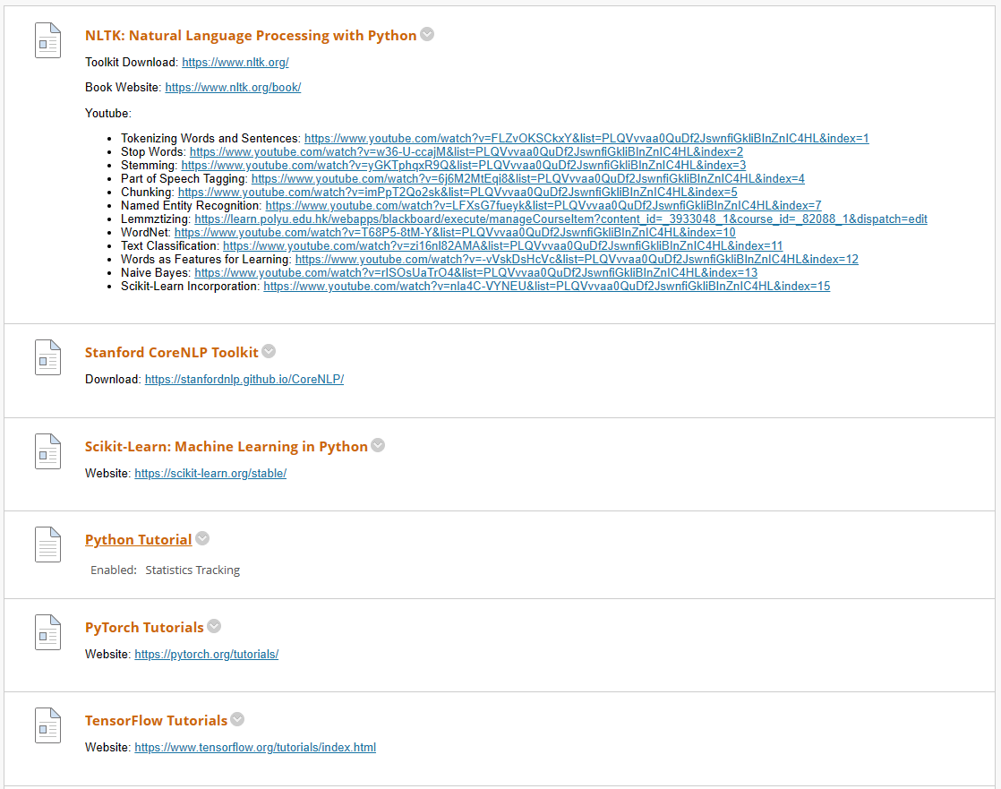

Slide 16


